Slide 1
Research Methodology 6. Pembimbingan dan Presentasi Penelitian
Romi Satria Wahono romi@romisatriawahono.net http://romisatriawahono.net/rm WA/SMS: +6281586220090

Slide 2
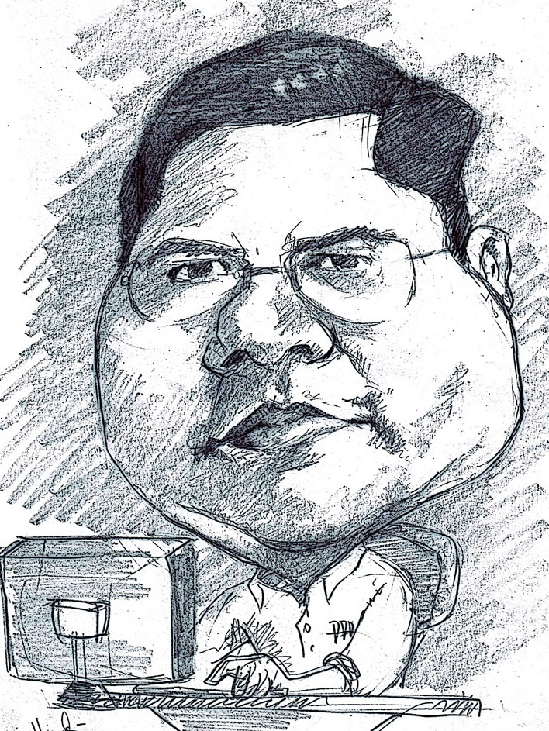
Romi Satria Wahono
SD Sompok Semarang (1987)
SMPN 8 Semarang (1990)
SMA Taruna Nusantara Magelang (1993)
B.Eng, M.Eng and Ph.D in Software Engineering from Saitama University Japan (1994-2004) Universiti Teknikal Malaysia Melaka (2014)
Research Interests: Software Engineering, Intelligent Systems
Founder dan Koordinator IlmuKomputer.Com
Peneliti LIPI (2004-2007)
Founder dan CEO PT Brainmatics Cipta Informatika

Slide 3
Course Outline
1. Pengantar Penelitian
2. Tahapan Penelitian
3. Literature Review
4. Penulisan Ilmiah dan Publikasi Penelitian
5. Systematic Literature Review (SLR)
6. Pembimbingan dan Presentasi Penelitian

Slide 4
6. Pembimbingan dan Presentasi Penelitian
6.1 Pembimbingan Penelitian
6.2 Tools Pembimbingan Penelitian
6.3 Kiat Mempersiapkan Slide dan Presentasi
6.4 Parameter Penilaian Presentasi Penelitian

Slide 5
6.1 Pembimbingan Penelitian

Slide 6
Aktor dalam Penelitian Tesis
The student, who identifies, approaches and solves a problem
The supervisor, who guides you in your work
The examiner, who critically assesses your work

Slide 7
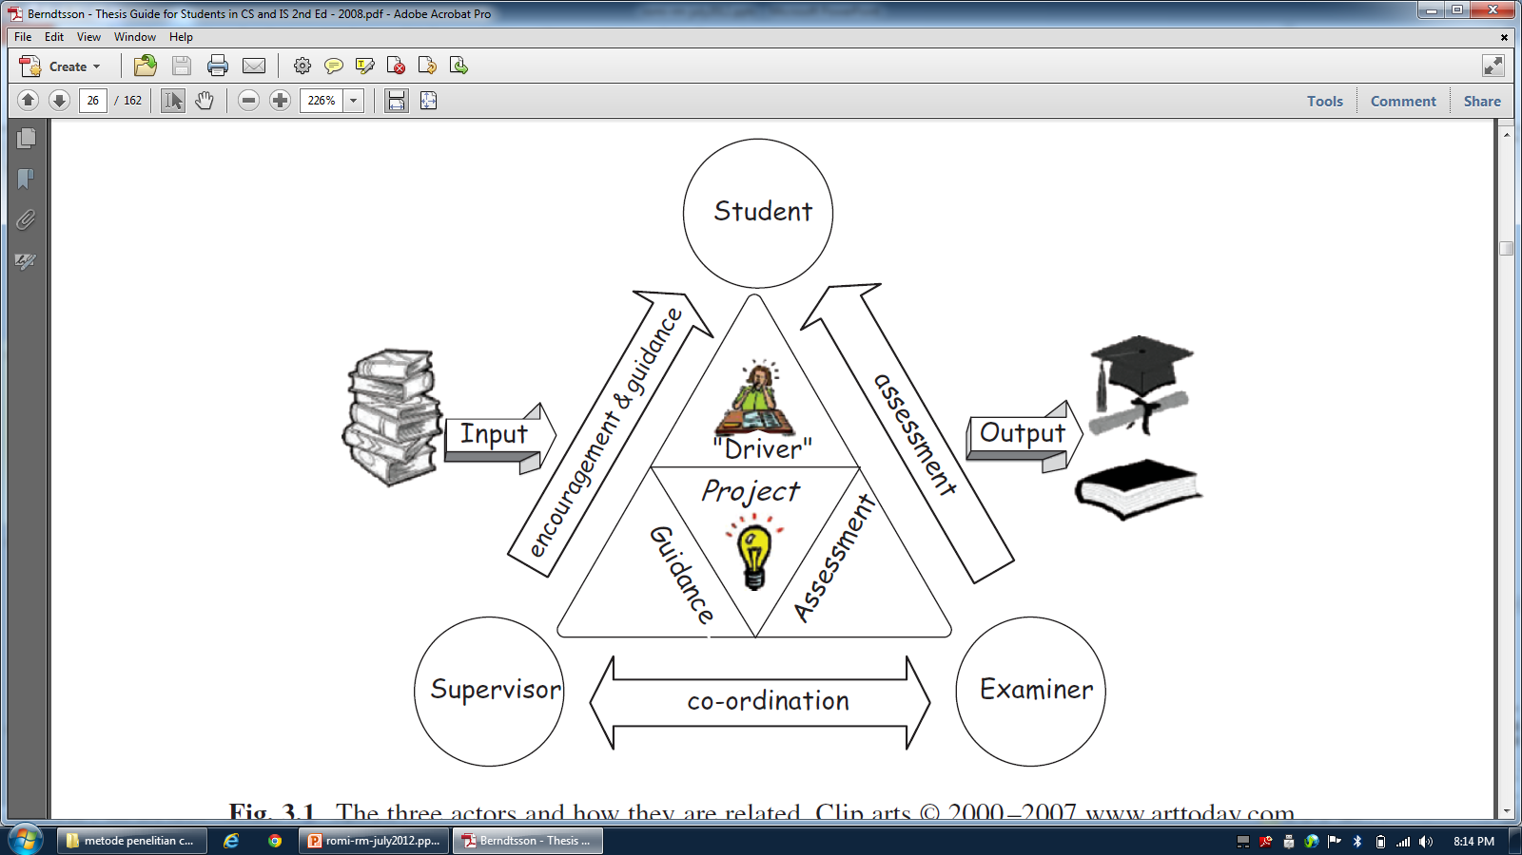
Student – Supervisor – Examiner

Slide 8
6.2 Tools Pembimbingan Penelitian

Slide 9
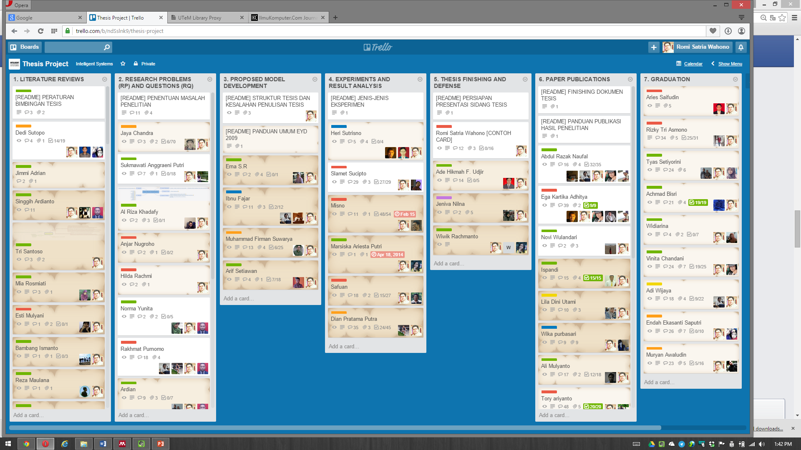
Pengelolaan Penelitian dengan Trello

Slide 10
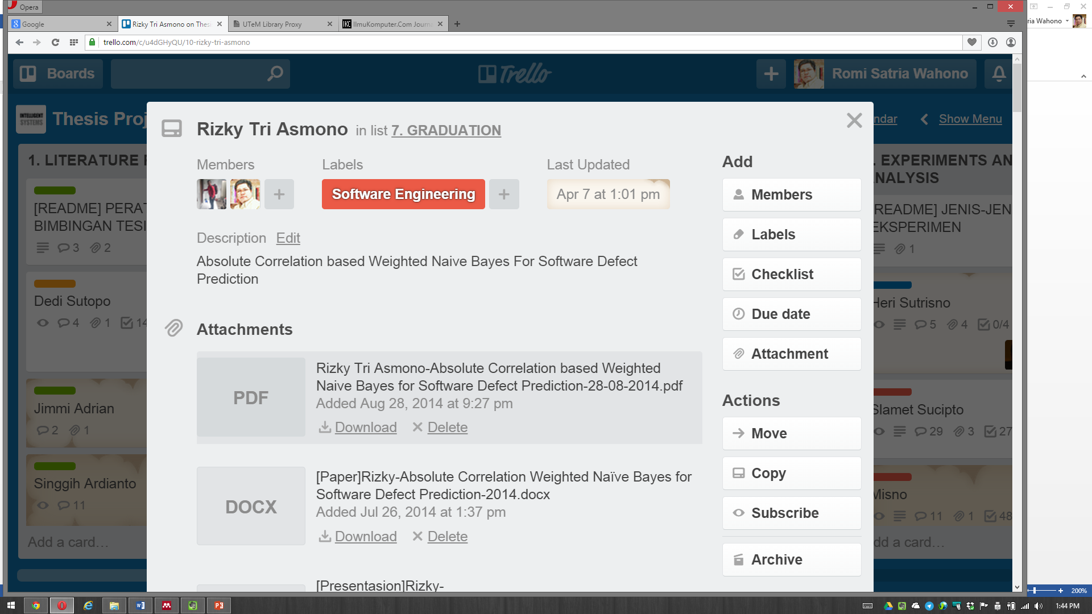
Contoh Card

Slide 11
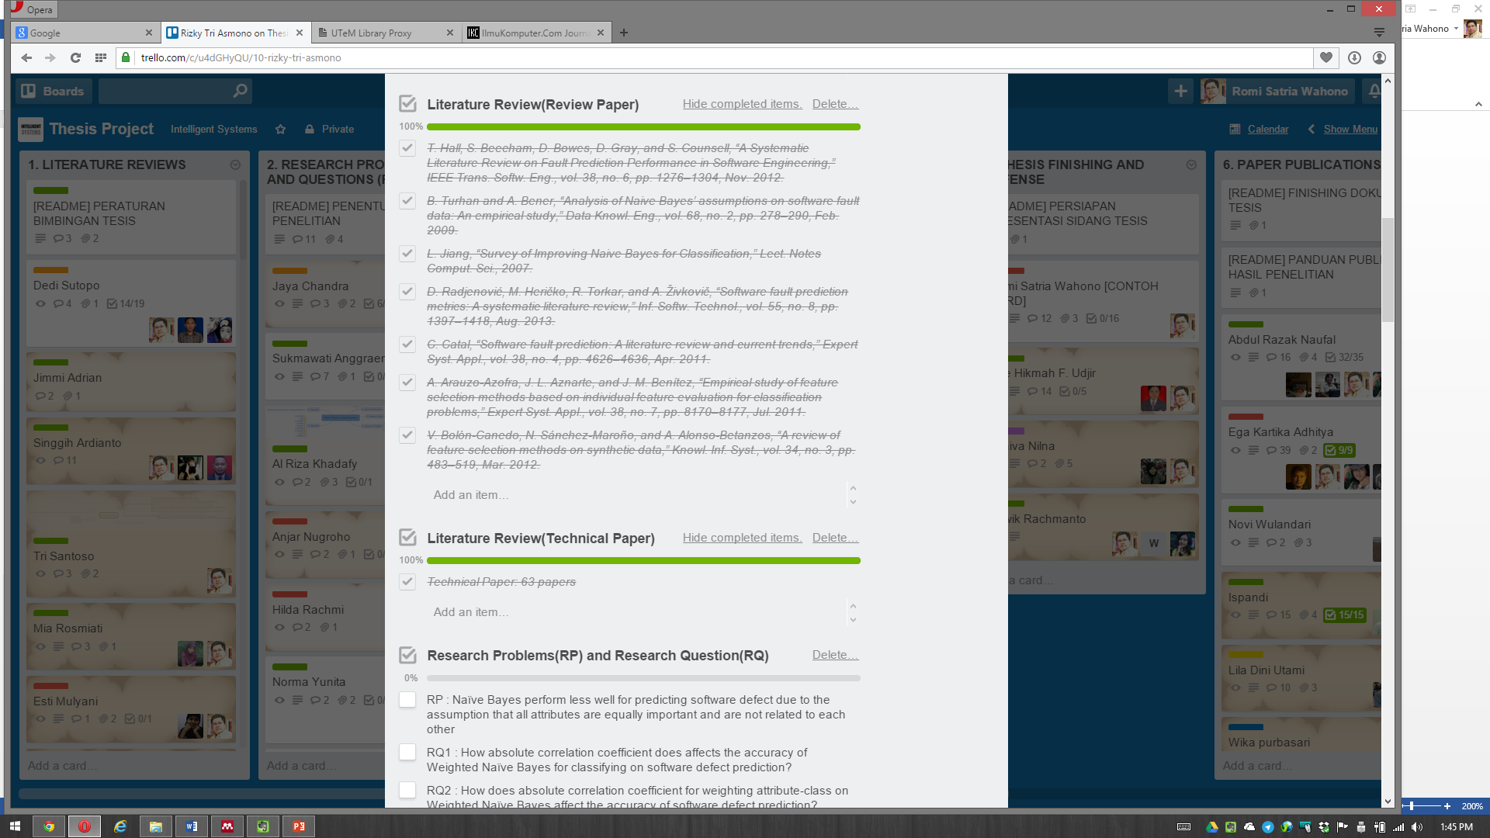
Contoh Card

Slide 12
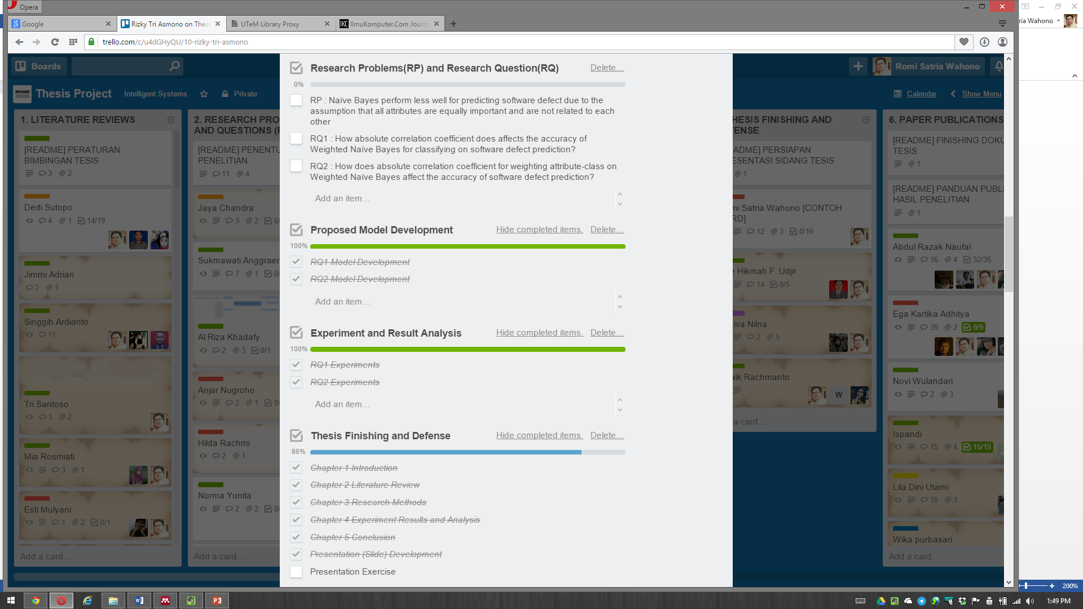
Contoh Card

Slide 13
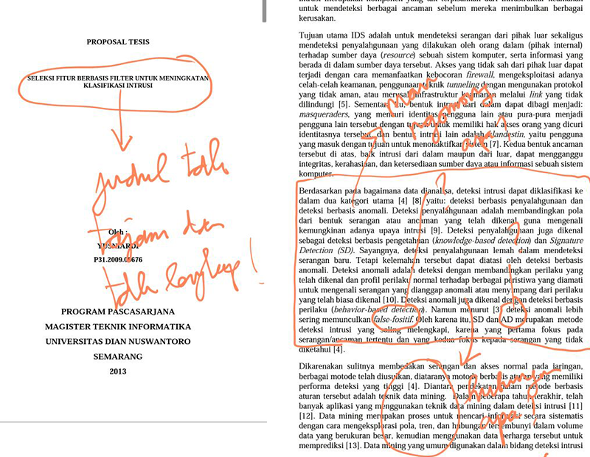
Contoh Hasil Koreksi

Slide 14
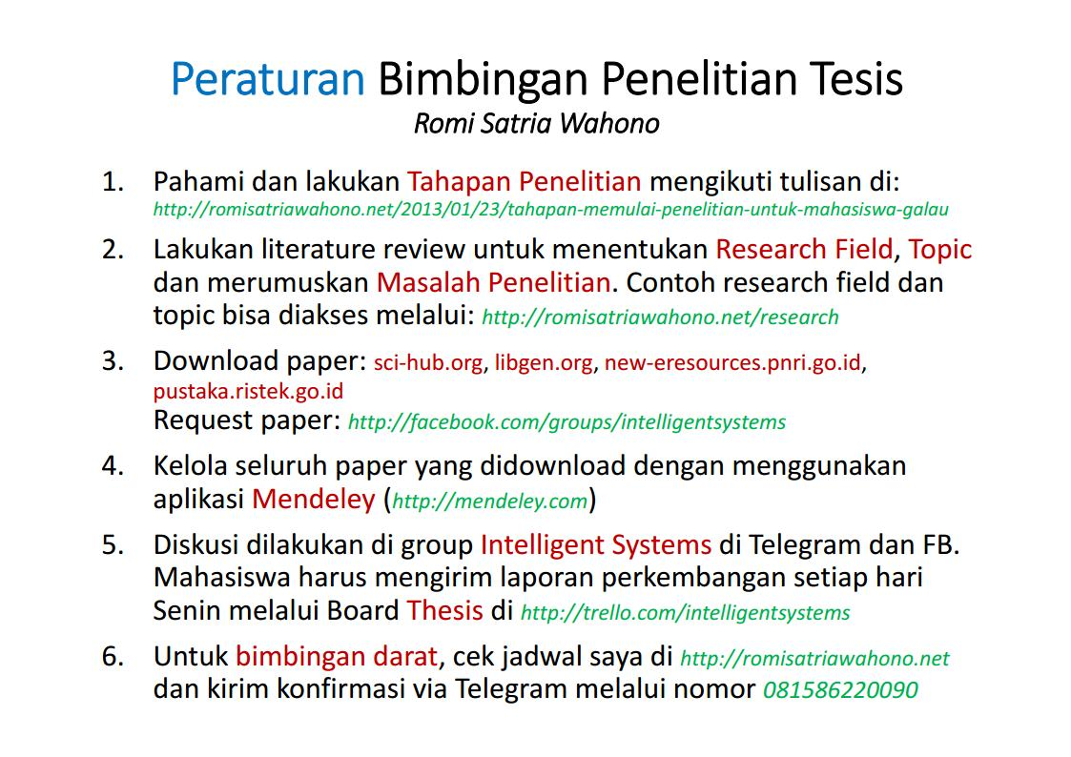
Contoh Peraturan Bimbingan

Slide 15
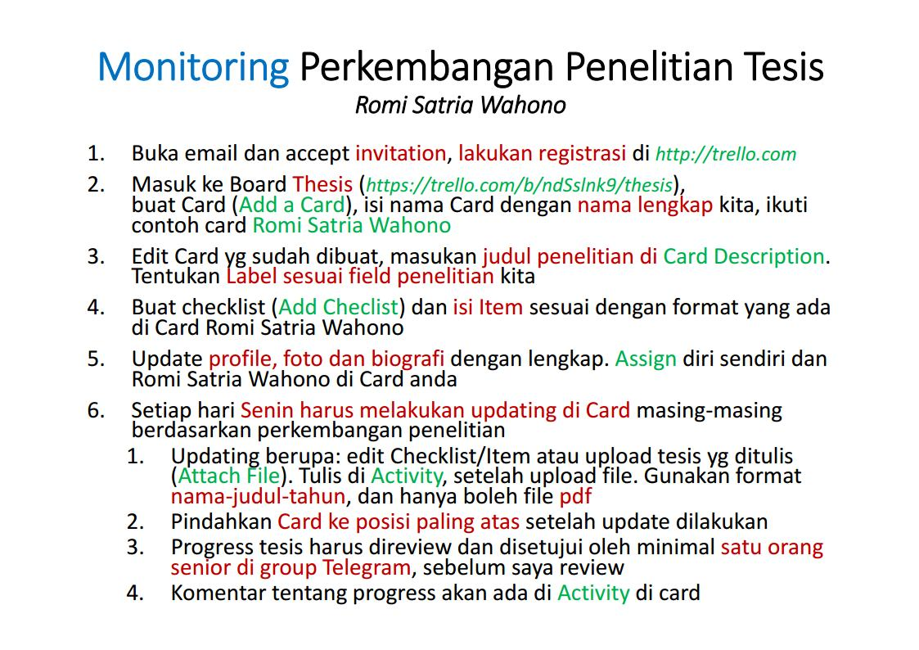
Contoh Peraturan Bimbingan

Slide 16
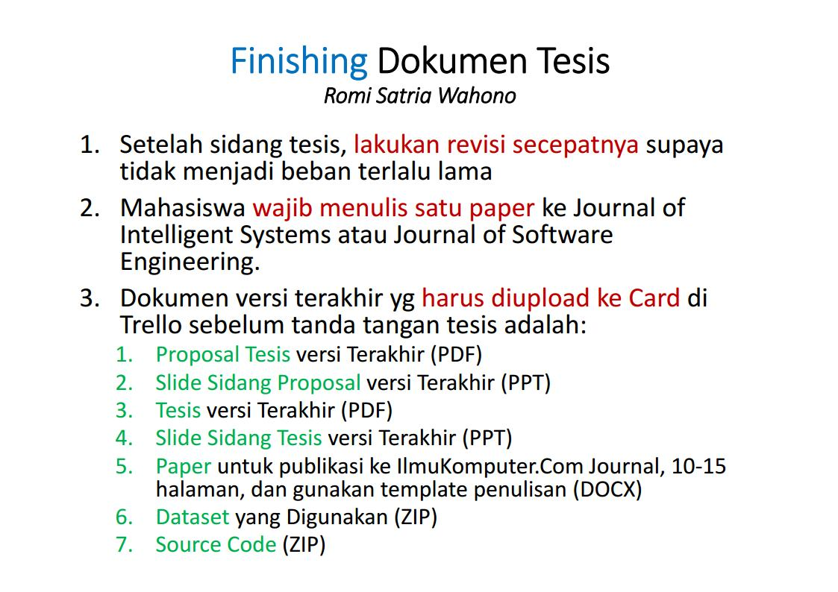
Contoh Peraturan Bimbingan

Slide 17
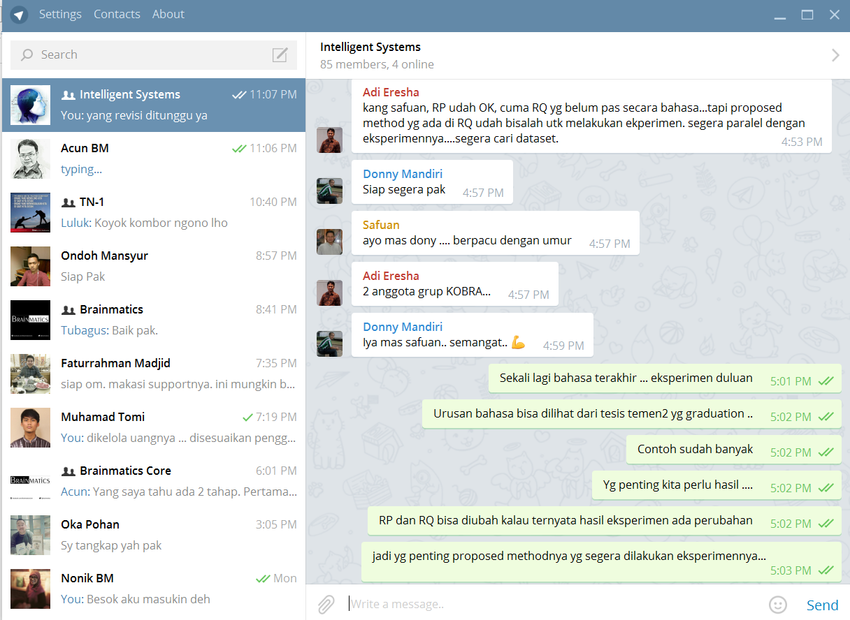
Diskusi di Grup Telegram

Slide 18
6.3 Kiat Mempersiapkan Slide dan Presentasi

Slide 19
Kiat Mempersiapkan Slide
Secara umum alur presentasi sebaiknya mengikuti alur tesis
Gunakan theme slide putih bersih, hindari menggunakan gambar dan animasi yang tidak perlu
Gunakan font hitam untuk isi slide, dan kata-kata yang penting bisa diberi penekanan dengan font warna merah atau biru
Ukuran font jangan lebih kecil dari 20pt, usahakan menggunakan 28pt atau 26pt
Citation boleh diselipkan di kalimat dalam slide, dengan font yang diset lebih kecil (18pt or 20pt)
Slide tidak berisi paragraph penuh, slide hanya poin-poin penting saja, berikan ilustrasi gambar bila diperlukan
Gunakan slide size standard (4:3) karena secara umum projector mendukung ukuran ini, jangan pernah gunakan size widescreen (16:9)

Slide 20
Kiat Presentasi di Ujian Tesis -1-
Lakukan presentasi dengan tenang, gunakan suara lantang dan meyakinkan
Atur suara supaya tidak terlalu tergesa-gesa dan juga tidak terlalu lambat
Beri penekanan suara terhadap poin-poin yang kita anggap penting
Jangan pernah membaca slide! Kita akan kehilangan ruh terhadap presentasi kita bila mulai membaca slide
Slide hanya berisi poin-poin, karena itu hapalkan kalimat yang ingin kita ungkapkan dengan berdasarkan ke poin-poin di slide tersebut

Slide 21
Kiat Presentasi di Ujian Tesis -2-
Dalam sesi tanya jawab, dengarkan dengan tenang, catat bila perlu apa yang diungkapkan penguji. Tunggu sampai penguji selesai bicara, jangan memotong dengan jawaban singkat, karena itu membuat jawaban kita tidak komprehensif, dan ide kita gampang dijatuhkan
Pahami dan hapalkan referensi utama kita, jawab pertanyaan dengan suara lantang dan meyakinkan, dengan landasan yang shahih dan jelas dari referensi yang kita pahami tersebut
Jangan mendebat dengan tanpa landasan, jangan banyak gunakan “saya duga/pikir”, terima kalau koreksi dari penguji memang logis, sampaikan bahwa akan melakukan revisi di bagian yang telah dikoreksi penguji

Slide 22
6.4 Parameter Penilaian Presentasi Penelitian

Slide 23
Penilaian Presentasi Penelitian (Berndtsson, 2008)
General: Examiners will look at the relevance and appropriateness of the topic you have studied, the significance of the findings and the amount of contribution you have achieved
Report: Examiners will look for clarity, consistency, an appropriate use of arguments, a clear differentiation between your own work and that of others in the literature and appropriate referencing
Defence: Examiners will assess the types of arguments you have made to support and defend your claims and conclusions. They will also look for your own insight and understanding in the work you have presented
Other: Examiners will review the administrative issues of your project. For example, have you followed the regulations correctly? Have you provided the right documentation at the right time?

Slide 24
Penilaian Presentasi Penelitian (Berndtsson, 2008)
General
Relevance of chosen topic
Originality of chosen topic
Significance of findings
Degree to which the work is the student’s own work
Report
Clarity of presentation
Consistency between different parts of the report
Degree of insight apparent from the arguments presented to support the choices that the student has made
Ability to differentiate between others’ thoughts and own
Ability to handle references and citations
General stylistic impression

Slide 25
Penilaian Presentasi Penelitian (Berndtsson, 2008)
Defence
Degree of insight apparent from the arguments presented to support claims and conclusions
Degree of insight apparent from discussion in response to relevant questions
Other
How the students performed as opponent
Fulfillment of deadlines and other formal requirements

Slide 26
Penilaian Presentasi Penelitian (Chinneck, 1999)
What was the research question?
Is it a ‘good’ question? This involves a comprehensive literature review to ensure that the question is ‘useful’ – i.e., worth answering. Through the literature review the student will show the context of the question, that the question has not been answered before and the extent to which others may have partly answered the question in the past.
Has the student answered the question adequately?
Has the student made an adequate contribution to knowledge?

Slide 27
Penilaian Presentasi Penelitian (Dawson, 2009)
General considerations: These considerations occur in all types of projects at all degree levels
Foundations of your project: is its existence justified within other literature in the field?
The project approach from a technical perspective (i.e., not a project management viewpoint). Were the correct methods used? Were appropriate data gathered?
Results and contribution of the project. This is particularly important at postgraduate level where the ultimate contribution of the work is the quality measure used

Slide 28
Penilaian Presentasi Penelitian (Wahono, 2015)
Research:
Validasi Masalah dan Kontribusi Penelitian
Metode Penelitian, Evaluasi dan Validasi Metode Yang Diusulkan
Hasil Penelitian dan Penarikan Kesimpulan
Report:
Teknik Penulisan Ilmiah
Penerapan Standard Formatting
Citation and Reference
Presentation:
Alur dan Tahapan Presentasi
Penguasaan Materi Presentasi
Argumentasi dalam Mempertahankan Ide

Slide 29
Reference
Abbott, M., & McKinney, J. (2013). Understanding and Applying Research Design. John Wiley & Sons, Inc.
Berndtsson, M., Hansson, J., & Olsson, B. (2008). Thesis Projects: a Guide for Students in Computer Science and Information Systems (2nd ed.). London: Springer-Verlag
Blaxter, L., Hughes, C., & Tight, M. (2006). How to Research (3rd ed.). Open University Press
Blessing, L. T. M., & Chakrabarti, A. (2009). DRM, a Design Research Methodology. Springer-Verlag London
Cohen, L., Manion, L., & Morrison, K. (2005). Research Methods in Education (5th ed.). Taylor & Francis Group
Dawson, C. W. (2009). Projects in Computing and Information Systems A Student’s Guide (2nd ed.). Pearson Education Limited
Jonker, J., & Pennink, B. (2010). The Essence of Research Methodology. Springer-Verlag Berlin Heidelberg
Lichtfouse, E. (2013). Scientific Writing for Impact Factor Journals. Nova Science Publishers, Inc.

Slide 30
Reference
Kothari, C. (2004). Research Methodology: Methods and Techniques. New Age International
Might, M. (2010). The Illustrated Guide to a Ph.D. Matt.might.net. Retrieved from http://matt.might.net/articles/phd-school-in-pictures/
Marczyk, G., DeMatteo, D., & Fertinger, D. (2005). Essentials of Research Design and Methodology. John Wiley & Sons, Inc.
Rea, L. M., & Parker, R. A. (2014). Designing and Conducting Survey Research: A Comprehensive Guide (4th ed.). John Wiley & Sons, Inc.
Runeson, P., Host, M., Rainer, A., & Regnell, B. (2012). Case Study Research in Software Engineering: Guidelines and Examples. John Wiley & Sons, Inc.
Sahu, P. K. (2013). Research Methodology: A Guide for Researchers In Agricultural Science, Social Science and Other Related Fields. Springer
Veit, R., Gould, C., & Gould, K. (2013). Writing, Reading, and Research (9th ed.). Cengage Learning

